Slide 1

On Becoming a Leader in Risk Management
Fundamentals of RM
RM system and process
Leadership in RM
Incident investigation
RM tools and challenges
RM in industry
People & Org.
Application and perspectives
ENGG404 – Lecture
Chapter 4.2: Cause and Effect Model for Incident Analysis
Chapter 4.3: Root Cause Analysis of an Incident
1
Notes:
1

Slide 2
Learning Outcomes:
Analyze an incident sequentially and explain the nature of the different types of causes, and their sub-categories.
Logically link the causal factors in incident investigations.
Interpret and create a Cause and Effect Model for analyzing incidents
Interpret, apply and construct a Root Cause Analysis of a loss incident.
Differentiate between immediate, basic, and latent causes.
Link a latent cause to a management system element and create a recommendation.
Chapter 4.2: Cause and Effect Models
Chapter 4.3: Root Cause Analysis of an Incident
2
Notes:
2

Slide 3
Introduction:
Two complementary tools for Incident Investigation: Cause and Effect Model and Root Cause Analysis
These will allow you to:
Find all potential cause-effect relationships in a logical manner,
Classify causes by their type such that they can be better understood and recommendations are optimized;
Link incident causes with failures in the RMS
Enhance communication with stakeholders
The Cause and Effect Model is used to check the thoroughness of the Root Cause Analysis for Incident investigation.
Chapter 4.2: Cause and Effect Models
Chapter 4.3: Root Cause Analysis of an Incident
3
Notes:
3

Slide 4
Important to keep in mind:
Easy to confuse causes, effects, and consequences.
Easy to jump to conclusions and make logic leaps
First, the facts and sequence [timeline] of events are needed! (incident investigation work process)
Then apply the root cause analysis work process, aided by the cause and effect models.
Chapter 4.2: Cause and Effect Models
Chapter 4.3: Root Cause Analysis of an Incident
4
Notes:
4

Slide 5
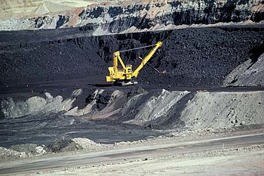
You are called to a scene where a mining haul truck and a shovel have been crushed with debris from an adjacent slope. You find one individual with a severe injury. You know the slopes are being monitored, you know there are procedures for safe work near the slopes, and you know it had been raining for the last week.
Using your best engineering judgment and deduction skills, please confer and discuss what the PEAP losses and causes were for this incident
Chapter 4.2: Cause and Effect Models
Chapter 4.3: Root Cause Analysis of an Incident
5
Notes:
5

Slide 6
Cause and Effect Models:
The Cause and Effect Models can be used to:
Categorize and summarize the facts of a loss incident.
Communicate the nature of an incident and its causes.
Check the thoroughness of the incident investigation & root cause analysis.
Chapter 4.2: Cause and Effect Models
Chapter 4.3: Root Cause Analysis of an Incident
6
Notes:
6

Slide 7
Cause and Effect Models:
Two models: simple and detailed.
Chapter 4.2: Cause and Effect Models
Chapter 4.3: Root Cause Analysis of an Incident
7
Notes:
7

Slide 8
Chapter 4.2: Cause and Effect Models
Chapter 4.3: Root Cause Analysis of an Incident
8
Notes:
8

Slide 9
Detailed Cause and Effect Model:
The 5 components are noted across the top:
Chapter 4.2: Cause and Effect Models Chapter 4.3: Root Cause Analysis of an Incident
9
Notes:
9

Slide 10
Detailed Cause and Effect Model:
The 5 components are noted across the top:
Chapter 4.2: Cause and Effect Models Chapter 4.3: Root Cause Analysis of an Incident
10
Notes:
10

Slide 11
Detailed Cause and Effect Model:
The 5 components are noted across the top:
11
Notes:
11

Slide 12
Detailed Cause and Effect Model:
The 5 components are noted across the top:
Chapter 4.2: Cause and Effect Models Chapter 4.3: Root Cause Analysis of an Incident
12
Notes:
12

Slide 13
Detailed Cause and Effect Model:
The 5 components are noted across the top:
13
Notes:
13

Slide 14
Some key points:
Remember to describe the losses in terms of PEAP
The incident description is essential for a robust RCA
Keeping the correct sequence of events is foundational for RCA
Your incident description states the facts (as you know them)
Short version for your RCA chart, longer version for your report.
Chapter 4.2: Cause and Effect Models
Chapter 4.3: Root Cause Analysis of an Incident
14
Notes:
14

Slide 15
Nature of the different groups of causes:
Immediate Causes – two categories (SCs and SPs): typically technical factors and actions (lack of)
Basic Causes - some referred to Human Behaviours (or human factors)
Latent Causes – directly associated to failures or weaknesses in the Risk Management System
Important! Latent Causes ARE NOT the elements of the Risk Management System
Chapter 4.2: Cause and Effect Models
Chapter 4.3: Root Cause Analysis of an Incident
15
Notes:
15

Slide 16
With this basic knowledge, and for our example of the mining incident:
“You are called to a scene where a mining haul truck and a shovel have been crushed with debris from an adjacent slope. You find one individual with a severe injury. You know the slopes are being monitored, you know there are procedures for safe work near the slopes, and you know it had been raining for the last week.”
Incident: “Debris fell on equipment adjacent to slope causing injury, equipment loss and production loss”
Consider the following and take your best assessment of the immediate causes:
- Debris fell
- Supervisor told operator to work in the exclusion zone
- Truck and shovel were inside the exclusion zone
- Slope was unstable
- Shovel operator was not aware of exclusion zone procedures
- Monitoring data was not evaluated
Chapter 4.2: Cause and Effect Models
Chapter 4.3: Root Cause Analysis of an Incident
16
Notes:
16

Slide 17


Incident & Losses
Debris fell on equipment, injuring one worker & damaging equipment
Immediate Causes
Debris Fell
Equipment & Operator Were In Exclusion Zone
Intermediate Causes
Unstable slope
Rain
Didn’t follow exclusion zone procedures
No effective warning
Chapter 4.2: Cause and Effect Models
Chapter 4.3: Root Cause Analysis of an Incident
27

Slide 18
How to Construct a Root Cause Analysis:
Steps:
Define and state the Incident Description.
Ask the question “why?” (a number of immediate causes)
For each subsequent cause, ask the same question, “why?”
Technical causes and human factor causes at the initial levels and in the deeper levels as the analysis is drilled down. Continue to drill down until the latent causes have been reached.
Ultimately, a point will be reached where the latent causes are found.
Avoid “logic leaps”.
Chapter 4.2: Cause and Effect Models
Chapter 4.3: Root Cause Analysis of an Incident
18
Notes:
18

Slide 19
Root Cause analysis:
Logical breakdown to identify the causes of an incident, including
immediate causes,
basic causes, and
latent causes.
Identifies actual causes as well as possible, probable, or conceivable causes.
The starting point is the Incident Description.
Describes the sequence of events leading up to the incident – in detail.
It is intended to drill down to the latent causes.
Once latent causes (RMS element weaknesses) are identified, needed improvements become evident and can be recommended.
Chapter 4.2: Cause and Effect Models
Chapter 4.3: Root Cause Analysis of an Incident
19
Notes:
19

Slide 20
Root Cause analysis:
Some benefits
Focuses on one specific cause at a time.
Identifies all causes through brainstorm thinking, supported by evidence.
Provides a visual representation of the incident in a clear and logical manner.
Chapter 4.2: Cause and Effect Models
Chapter 4.3: Root Cause Analysis of an Incident
20
Notes:
20

Slide 21
Nomenclature and Symbols for Root Cause Analysis:
What is needed to cause a possible incident?
“AND” Gate: How activities and conditions are viewed in order to cause an event:
One possibility is a combination of activities must happen i.e. Activity A AND Activity B
Another possibility is a combination of conditions must be present i.e. Condition A AND Condition B
And another possibility is a combination of activities must happen and conditions must be present i.e. Activity A AND Condition B.
Also: Behaviour A AND Operation B.
“OR” Gate: How activities and conditions are viewed in order to cause an event:
One of several activities must happen i.e. Activity A OR Activity B
One of several conditions must be present i.e. Condition A OR Condition B
One of several activities must happen or conditions must be present i.e. Activity A OR Condition B.
Event
AND
A
B
Event
OR
A
B
Chapter 4.2: Cause and Effect Models
Chapter 4.3: Root Cause Analysis of an Incident
21
Notes:
21

Slide 22
Incident & Losses
Debris fell on equipment, injuring one worker & damaging equipment
Immediate Causes
Debris Fell
Equipment & Operator Were In Exclusion Zone
Intermediate Causes
Unstable slope
Rain
Didn’t follow exclusion zone procedures
No effective warning
Chapter 4.2: Cause and Effect Models
Chapter 4.3: Root Cause Analysis of an Incident
27

Slide 23
Aids for finding and classifying Causes
Recall your Cause and Effect Model. We will talk about these below:
Immediate Causes in two categories:
Substandard work practices and sub-groups
Substandard conditions and sub-groups
Basic Causes in three categories:
Engineering & Design Factors
Job Factors and sub-groups
Personal Factors and sub-groups
Latent Causes
Chapter 4.2: Cause and Effect Models
Chapter 4.3: Root Cause Analysis of an Incident
23
Notes:
23

Slide 24
Immediate Cause Categories: Substandard Conditions (SCs)
Substandard Practices (SPs)
24
Notes:
24

Slide 25
Practice: Immediate Causes - Categories and Sub-categories
Please confer (hands up):
From our Mining Haul incident example, identify the category and sub-category for these Immediate Causes:
Immediate causes:
Debris fell
Unstable slope
Equipment & operator in exclusion zone
Operator not following exclusion zone procedures
***First determine whether it is a substandard condition or a substandard practice
Chapter 4.2: Cause and Effect Models
Chapter 4.3: Root Cause Analysis of an Incident
25
Notes:
25

Slide 26
Basic Causes (Human/Personal Factors):
Difficult to identify; often not evident until after an incident has been investigated and analyzed.
Two Questions to ask to get the Basic Causes:
1) Why did that substandard practice occur?
2) Why did that substandard condition exist?
Chapter 4.2: Cause and Effect Models
Chapter 4.3: Root Cause Analysis of an Incident
26
Notes:
26

Slide 27
Match the best:
Some Basic Causes:
“Poor design” (unsafe)
Operator not aware of
signaling for safety distances
Operator thought the safe job procedure was hampering productivity
Basic Causes Categories:
Improper risk taking (Personal Factor)
Inadequate inherently safe design (Design Factor)
Inadequate training (Job Factors)
Chapter 4.2: Cause and Effect Models
Chapter 4.3: Root Cause Analysis of an Incident
27
Notes:
27

Slide 28
Incident & Losses
Debris fell on equipment, injuring one worker & damaging equipment
Immediate Causes
Debris Fell
Equipment & Operator Were In Exclusion Zone
Intermediate Causes
Unstable slope
Rain
Didn’t follow exclusion zone procedures
No effective warning
Basic Causes
Poor slope design
Poor slope construction
Monitoring data not evaluated
No effective communication
Not aware of exclusion zone procedures
Supervisor told him to be there
How could our basic causes be categorized?
Job factors, Personal Factors, Engineering & Design Factors?
Note the use of the word “poor”
Chapter 4.2: Cause and Effect Models
Chapter 4.3: Root Cause Analysis of an Incident

Slide 29
Practice: Basic Causes and Categories
Engineering & Design Factors: (can apply to structures, equipment, tools, i.e. any engineered system) | Job Factors: | Personal Factors:
inadequate technical design inadequate ergonomic design inadequate assessment of loss exposures inadequate standards, specifications and/or design criteria inadequate monitoring of construction inadequate assessment of operational readiness inadequate monitoring of initial operation inadequate evaluation and/or documentation of change inadequate inherently safe design | Inadequate maintenance Inadequate job procedures Error-inducing conditions Organizational factors Incompatible goals Inadequate training Inadequate communication | Inadequate physical / physiological state / capability to do the work. Perceived inadequate mental / psychological state / capability to do the work. Physical or physiological stress. Perceived mental or psychological stress. Improper risk taking / improper motivation Lack of knowledge / lack of skill.
Please confer and respond on MM-Open: For our example, what were the basic cause categories for the following?
Poor slope design:
Not aware of exclusion zone procedures:
Supervisor told operator to be in exclusion zone:
Monitoring data not evaluated:
Respond, for example: “a) EDF, inadequate technical design” “b) …”, etc.
Chapter 4.2: Cause and Effect Models
Chapter 4.3: Root Cause Analysis of an Incident
29
Notes:
29

Slide 30
Latent Causes:
When identified, the latent causes:
Relate to the elements of the management system
Reflect inadequacies in the management system
Meaningful management action and management control can be undertaken.
Leaders must drive the root cause analysis process to effectively find the Latent Causes.
There is no universal set of latent causes; they are expressed as weaknesses or failures in the management system elements for the organization.
Chapter 4.2: Cause and Effect Models
Chapter 4.3: Root Cause Analysis of an Incident
30
Notes:
30

Slide 31
Let’s show the root causes on the RCA!
“You are called to a scene where a
mining haul truck and a shovel have
been crushed with debris from an
adjacent slope. You find one individual
with a severe injury. You know the
slopes are being monitored, you know
there are procedures for safe work
near the slopes, you know it had been
raining for the last week.”
Chapter 4.2: Cause and Effect Models
Chapter 4.3: Root Cause Analysis of an Incident
31
Notes:
31

Slide 32

Incident & Losses
Debris fell on equipment, injuring one worker & damaging equipment
Immediate Causes
Debris Fell
Equipment & Operator Were In Exclusion Zone
Intermediate Causes
Unstable slope
Rain
Didn’t follow exclusion zone procedures
No effective warning
Basic Causes
Poor slope design
Poor slope construction
Monitoring data not evaluated
No effective communication
Not aware of exclusion zone procedures
Supervisor told him to be there
Supervisor valued production over safety
Deficient training program existed
No training program existed
Root Causes
Mgmt. didn’t see the need
RME #1
RME #9
RME #1
RME Element
Chapter 4.2: Cause and Effect Models
Chapter 4.3: Root Cause Analysis of an Incident

Slide 33
Key points:
Must relate the basic causes to the latent causes.
Requires a bit of reverse logic. A trick for when you are at that level of the analysis:
express each RMS element as a failure,
then compare each of these failures with the basic causes.
For reporting all causes types, not so important to align causes with the detailed lists; it is important to recognize cause type and in which major group a cause sits.
Chapter 4.2: Cause and Effect Models
Chapter 4.3: Root Cause Analysis of an Incident
33
Notes:
33

Slide 34
Latent Causes and the Risk Management System Elements:
Chapter 4.2: Cause and Effect Models Chapter 4.3: Root Cause Analysis of an Incident
34
Notes:
34

Slide 35
Latent Causes and the Risk Management System Elements:
Chapter 4.2: Cause and Effect Models Chapter 4.3: Root Cause Analysis of an Incident
35
Notes:
35

Slide 36
Categories for Latent Causes – P, S, and C:
“P” = Inadequate Program
Non-existent or lacking in many elements
“S” = Inadequate Program Standards
Program exists but supporting documents (policies, standards, procedures) are non-existent or inadequate.
Employees do not understand the standards or procedures
“C” = Inadequate Compliance with Standards
Program and supporting documentation exist, but work practices are not meeting requirements i.e. sub-standard.
Employees do not have access to standards or procedures
Chapter 4.2: Cause and Effect Models
Chapter 4.3: Root Cause Analysis of an Incident
36
Notes:
36

Slide 37
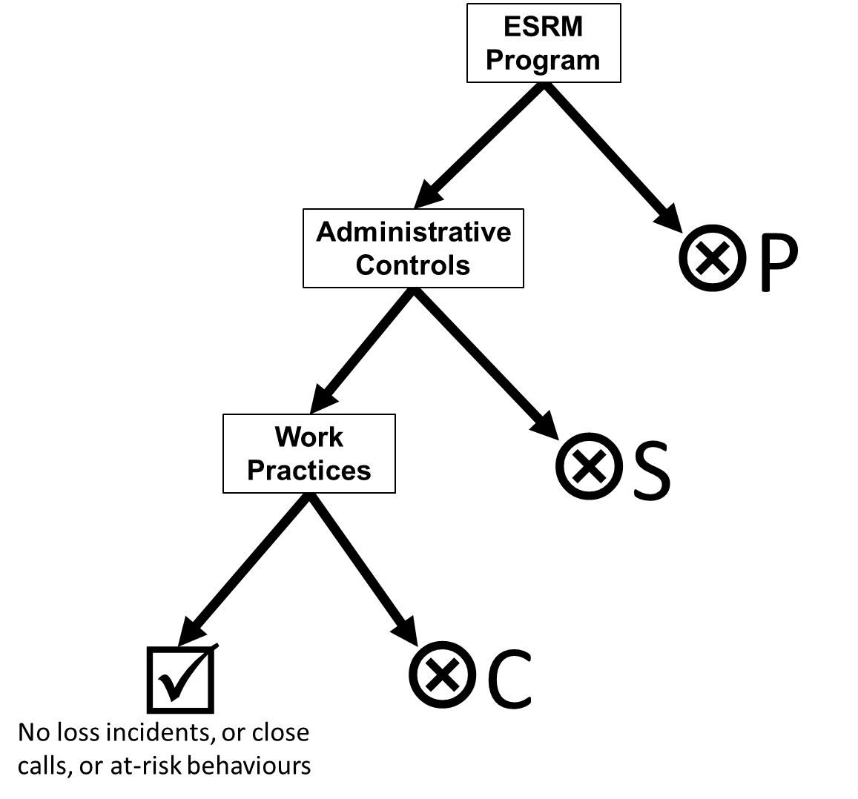
Example Model for the Set of Categories of Causes:
Chapter 4.2: Cause and Effect Models Chapter 4.3: Root Cause Analysis of an Incident
37
Notes:
37

Slide 38
Example Model for the Set of Categories of Causes:
Apply this concept to our mining case study. Show of hands, for the latent causes, choose their category (P or S or C):
#1: MLCA – supervisor prioritized production over safety
#1: MLCA– no exclusion zone training program existed
#9: EC&T – deficient exclusion zone procedures existed
Chapter 4.2: Cause and Effect Models Chapter 4.3: Root Cause Analysis of an Incident
38
Notes:
38

Slide 39
Developing an RCA: Breadth and Depth Illustrated
Chapter 4.2: Cause and Effect Models
Chapter 4.3: Root Cause Analysis of an Incident
39
Notes:
39

Slide 40
Answers from the class
Use the short version for the incident description (i.e. what will go at the top of the RCA chart)
40
Notes:
40

Slide 41
PEAP Losses
Propane vapor cloud exploded, creating a fireball and causing 2 deaths, equipment damage & resident evacuation
Chapter 4.2: Cause and Effect Models
Chapter 4.3: Root Cause Analysis of an Incident
ESRM - LRM
41
Notes:
41

Slide 42
Propane vapor cloud exploded…
Chapter 4.2: Cause and Effect Models
Chapter 4.3: Root Cause Analysis of an Incident
ESRM - LRM
42
Notes:
42

Slide 43
The Sunrise Propane Explosion Incident:
Propane Vapor Cloud Exploded
Please confer:
Further develop one of these two roots down to latent causes. 5 minutes for discussion.
Incident Description
“AND” Gate
O2
Ignition
Gas Release
EOL
“OR” Gate
“AND” Gate
Unplanned Release
Propane in Line
Smoking in Area
Metal Spark
Static Electricity
Faulty Elec. Equip.
“OR” Gate
Illegal Truck-to-truck Transfer
“OR” Gate
Transfer hose Ruptured
Hose fitting connection was loose
“OR” Gate
Workers Dis-regarded Policy?
No Policy?
Workers didn’t know hazards?
ESRM - LRM
43
Notes:
43

Slide 44


Transfer hose ruptured
Hose was defective
Hose was worn
Hose was overpressurized
Employees didn’t inspect the hose on a regular basis (BC – JF)
Employees regularly dragged hose across floor
Employees were rushing to complete T2T transfers
Hose was too heavy to carry
Chose not to inspect the hose weekly
Not aware they needed to inspect the hose weekly
Employees were paid based on volume of propane transferred (BC – PF)
Workers did not comply with the Hose Maintenance Inspection program (LC-C)
Training program on how to inspect and maintain hoses was inadequate (LC-P)
Mgmt set up a payment system based on volume
Mgmt prioritized profit over safety (LC)
RME #8 O&M
RME #9 EC&T
RME #1 MLC&A
44

Slide 45
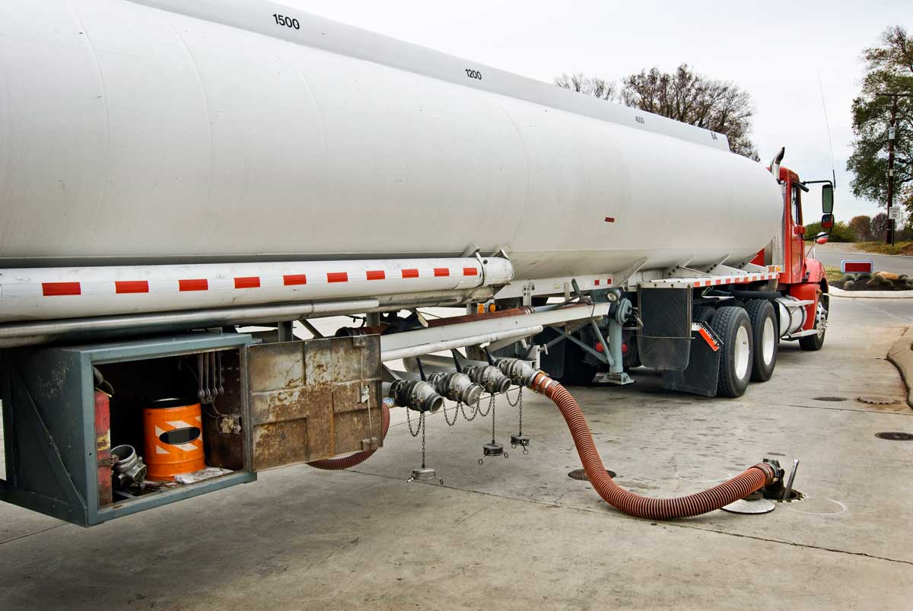
Hose fitting connection was loose
Hose fitting was too large for the connector on the truck
Employees were able to use a fitting too large for the connector
Employees chose to use a fitting too large for the connector
Design allowed the fitting to hook up to the connector (BC – E&DF)
Designers designed the fitting that way
An appropriate sized fitting for the connector was not available
Designers had never considered the risk from illegal T2T transfers of propane.
Employees were performing an illegal T2T transfer of propane
Designers’ work program (i.e. work process, how they do work) did not require an assessment of all hazards. (LC-S)
They were told by their supervisor to do a T2T transfer
Supervisor paid based on volume of propane transferred (BC – PF)
RME #2 RA&MR or #7 DC&SU
…RME #1 MLC&A
45

Slide 46
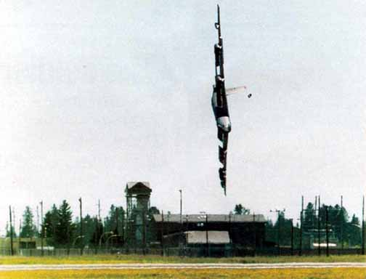
B-52 Czar Case Study on Leadership and Culture
Case Study: “Darker Shades of Blue”
The Incident
In four or five words, what happened?
Immediate Causes: What caused it to happen?
Substd. Work Practices (SP) and Substd. Conditions (SC)
Basic Causes?
What allowed the substd. conditions to exist?
Job, personal, E&D
Root Causes?
P, S, C?
Linked to which Management system deficiencies?

Slide 47
Summary and Key Points:
Categories and sub-categories of causes:
Immediate Causes
Basic Causes
Latent Causes
The Root Cause Analysis Chart is used to create a logical sequence and understanding of the causes of an incident
The Cause and Effect Model is used to categorize causes and to test the depth and breadth of a Root Cause Analysis.
Incidents ultimately have their roots in latent causes.
The culture of the organization is dependent on the leadership, and latent causes relating to leadership are often found at the root of major loss incidents.
Chapter 4.2: Cause and Effect Models
Chapter 4.3: Root Cause Analysis of an Incident
47
Notes:
47

